Slide 1
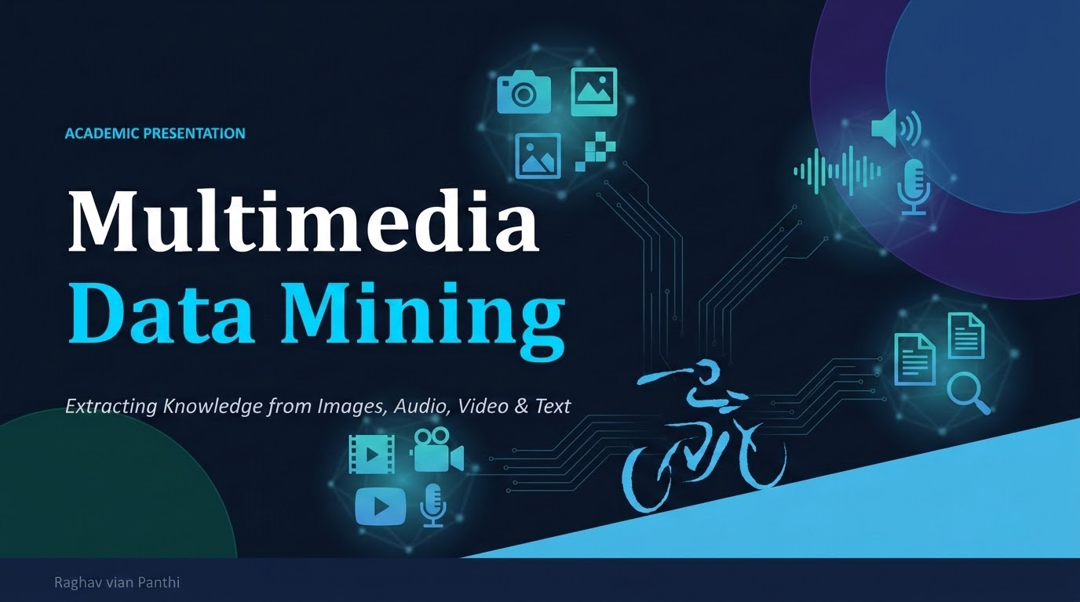

Slide 2
AGENDA
01
Introduction to Multimedia Data Mining
Topics
Covered
02
Types of Multimedia Data
03
Key Techniques & Algorithms
04
Applications & Use Cases
05
Challenges & Future Trends

Slide 3
01
What is Multimedia Data Mining?
Multimedia Data Mining is the process of finding useful patterns and information from large amounts of multimedia data, such as text, images, audio, and video, using data mining and machine learning techniques.
80%
10× Faster
2.5 Billion GB
of all data generated globally is multimedia
data analysis than manual methods
of data created every single day

Slide 4
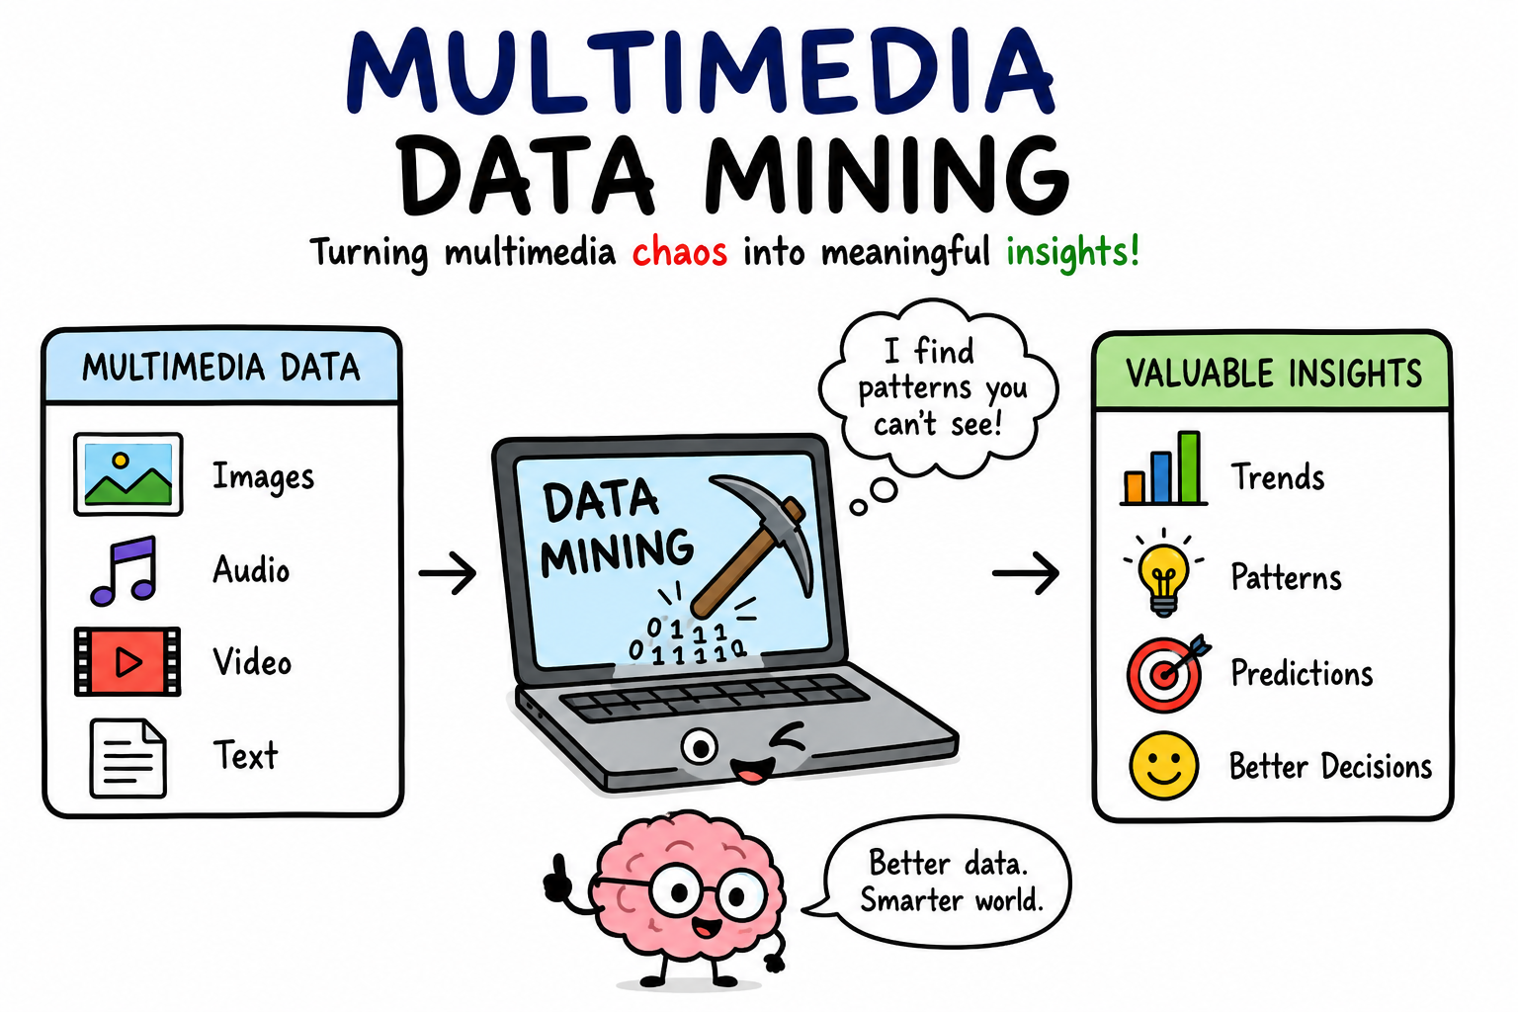

Slide 5

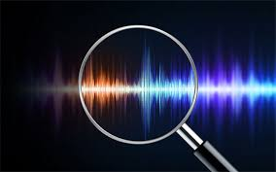
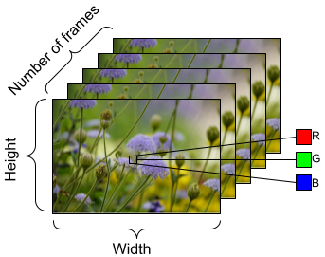
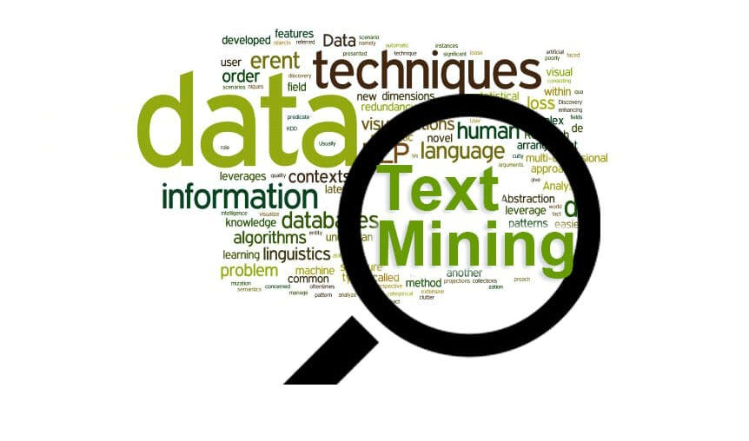
02
Types of Multimedia Data
🖼 Image Data
🎵 Audio Data
JPEG, PNG, BMP images
Pixel and color features by
edge maping extraction
Object and face recognition
Medical images (MRI, X-ray)
Speech and music
Sound wave patterns
Spectrogram analysis
{ xaxis y axis}
Speaker and emotion detection
🎬 Video Data
📝 Text Data
Sequence of image frames
Motion detection
Scene detection
Video surveillance cctv
bata chori herne
Documents and captions
OCR (text from images)
Sentiment analysis
Keywords and text
features

Slide 6
03
Key Techniques & Algorithms
Feature Extraction
Clustering
Classification
Extract important features from multimedia data.
Examples: SIFT MFCC CNN features
Group similar multimedia data automatically.
Example:K-Means, DBSCAN,
Classify multimedia into predefined categories.
Example:SVM,Random Forest ,Deep Neural Networks
Similarity Search
Deep Learning
Association Mining
Use neural networks to automatically learn complex multimedia patterns.
Examples: CNN (Images)
RNN/Transformers (Audio & Text).GANs (GenerateImages)
Find relationships between different multimedia data.
Example: A news article with images and videos about the same event.
Find images, videos, or audio similar to a given item.
Example: Google Images "Search by Image"

Slide 7
04
Applications & Use Cases
🏥
Healthcare
🔒
Security
🔍
Search Engines
Analyze medical images, detect diseases, classify X-rays and MRI scans.
Face recognition, fingerprint matching, video surveillance, detect suspicious activities.
Search by image, video search, audio recognition .
🛒
E-Commerce
🎬
Entertainment
🌍
Geospatial
Product search by image, product recommendations, detect fake products.
content Recommend movies/music, create video highlights.
nalyze satellite images, disaster monitoring, detect land changes. ex:: glof flood detection.

Slide 8
05
Challenges & Future Trends
⚠ Current Challenges
🚀 Future Trends
→ Multimedia data has many features making analysis more complex.
→ Multimodal Large Language Models (GPT-4V, Gemini)
→Computers find it difficult to understand the real meaning of multimedia data.
→ AI learns with fewer labeled examples.
→ Massive storage and computational costs
→ Real-time live video analyzes
→ Protecting users' personal and biometric data is a challenge.
→ AI explains why this decision is made.
→ There is not enough labeled data to train AI models. no predefine data
→ AI learns while keeping user data private.
→ Combining different types of multimedia data is challenging.
→ 3D & AR/VR data mining

Slide 9
KEY TAKEAWAYS
Summary
🔍
Multimedia data mining unlocks insights hidden in images, audio, video, and text
🤖
Deep learning & multimodal AI are revolutionizing the field rapidly
🌐
Applications span healthcare, security, search, retail, and beyond
⚡
Key challenges include the semantic gap, computational cost, and privacy
🔮
The future is multimodal — fusing all data types for richer intelligence

